Slide 1
Fastest Approach to Exact Pattern Matching
Date:102/3/13
Publisher:Information and Emerging Technologies (ICIET), 2010
Author:Iftikhar Hussain, Imran Ali, Muhammad Zubair and Nazarat Bibi
Presenter : Shi-qu Yu

Slide 2
Boyer and Moore Algorithm
The algorithm compares the pattern P with the substring of sequence T within a sliding window in the right-to-left order.
The bad character rule and good suffix rule are used to determine the movement of sliding window.

Slide 3
Bad Character Rule
Suppose that P₁ is aligned to T_{s} now, and we perform a pair-wise comparing between text T and pattern P from right to left. Assume that the first mismatch occurs when comparing T_{s+j-1} with P_{j} .
Since T_{s+j-1} ≠P_{j} , we move the pattern P to the right such that the largest position c in the left of P_{j} is equal to T_{s+j-1}. We can shift the pattern at least (j-c) positions right.
s
s +j -1
T |  |  | x | t
P |  | x |  | y | t
1
c
j
m
Shift
P |  | x |  | y | t
1
j
m

Slide 4
Rule 2-1: Character Matching Rule (A Special Version of Rule 2)
Bad character rule uses Rule 2-1 (Character Matching Rule).
For any character x in T, find the nearest x in P which is to the left of x in T.

Slide 5
Implication of Rule 2-1
Case 1. If there is a x in P to the left of T, move P so that the two x’s match.

Slide 6
Case 2: If no such a x exists in P, consider the partial window defined by x in T and the string to the left of it.

Slide 7
Good Suffix Rule 1
If a mismatch occurs in T_{s+j-1}, we match T_{s+j-1} with P_{j’-m+j} , where j’ (m-j+1≦ j’ < m) is the largest position such that
(1) P_{j+1,m} is a suffix of P_{1,j’}
(2) P_{j’-(m-j)} ≠P_{j}.
We can move the window at least (m-j’) position(s).
s
s+j-1
T |  |  | x | t
P |  | z | t |  | y | t
1
j’-m+j
j’
j
m
Shift
P |  | z | t |  | y | t
1
j’-m+j
j’
j
m
z≠y

Slide 8
Rule 2: The Substring Matching Rule
For any substring u in T, find a nearest u in P which is to the left of it. If such a u in P exists, move P; otherwise, we may define a new partial window.

Slide 9
Good Suffix Rule 2
Good Suffix Rule 2 is used only when Good Suffix Rule 1 can not be used. That is, t does not appear in P(1, j). Thus, t is unique in P.
If a mismatch occurs in T_{s+j-1}, we match T_{s+m-j’} with P₁, where j’ (1≦ j’ ≦ m-j) is the largest position such that
P_{1,j’} is a suffix of P_{j+1,m}.
s
s+j-1
s+m-j’
T |  |  | x | t
t’
P | t’ |  | y | t
1
j’
j
t’
m
Shift
P | t’ |  | y | t
1
j’
j
m
P.S. : t’ is suffix of substring t.

Slide 10
Rule 3-1: Unique Substring Rule
The substring u appears in P exactly once.
If the substring u matches with T_{i,j} , no matter whether a mismatch occurs in some position of P or not, we can slide the window by l.
T:
P:
The string s is the longest prefix of P which equals to a suffix of u.
i
u
j
 |  | s
u
s |  |  | s
s |  | u
l

Slide 11
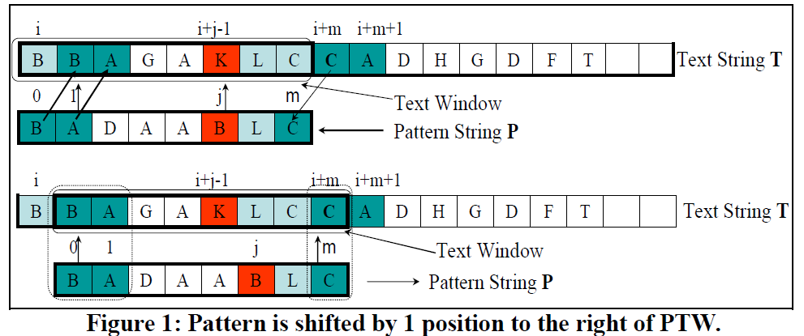
Fastest-Bidirectional Case 1

Slide 12
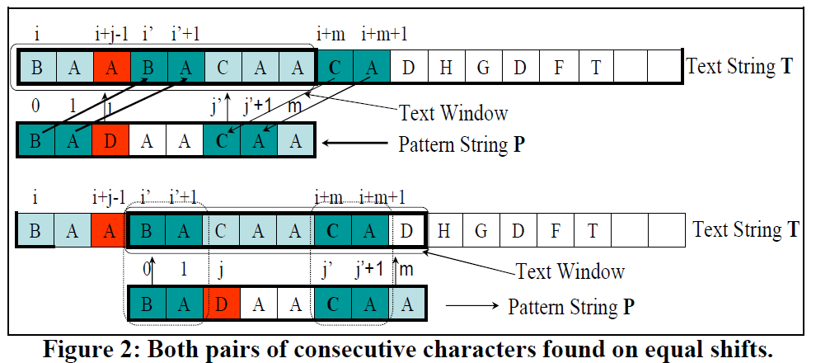
FBD Case 2

Slide 13
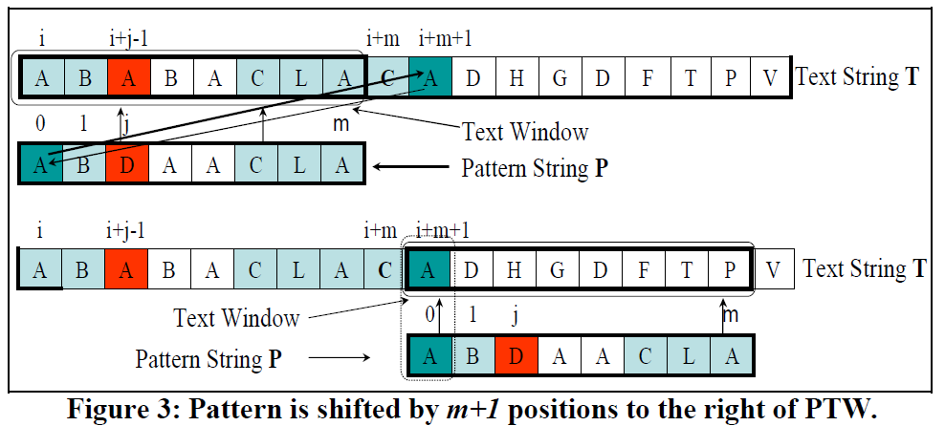
FBD Case 3

Slide 14
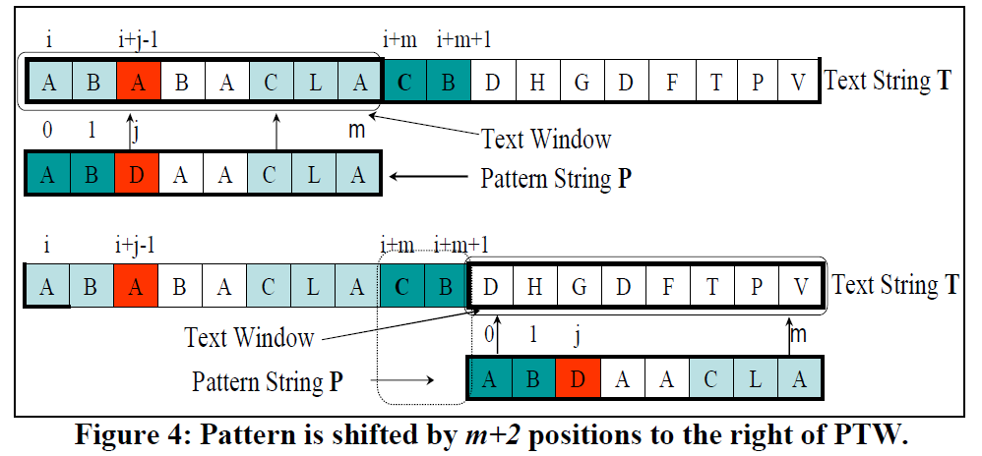
FBD Case 4

Slide 15
12 comparisons in 5 attempts

Slide 16
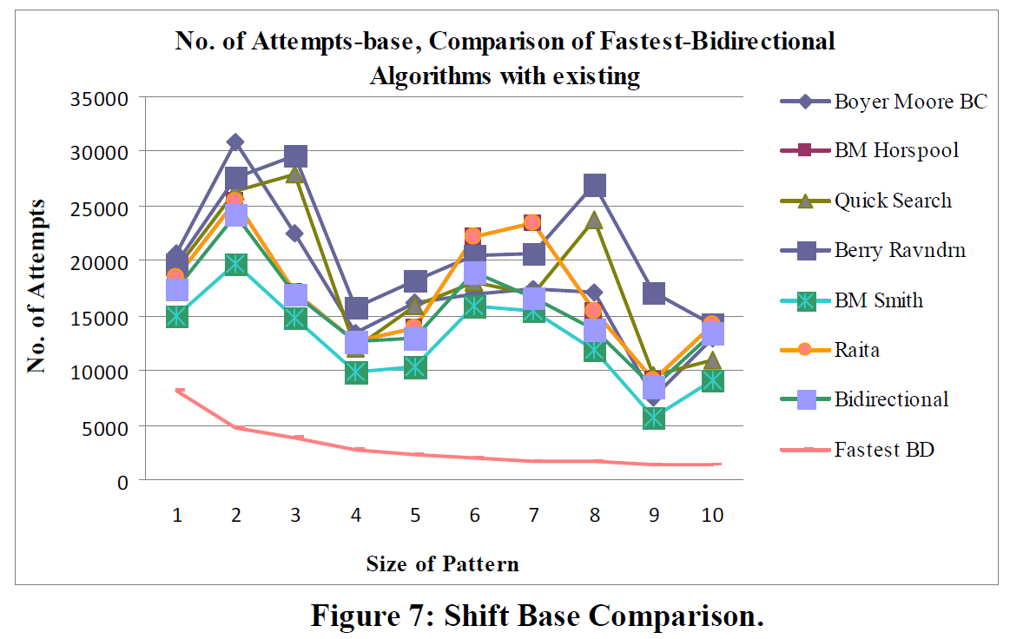
RESULTS AND DISCUSSIONS

Slide 17
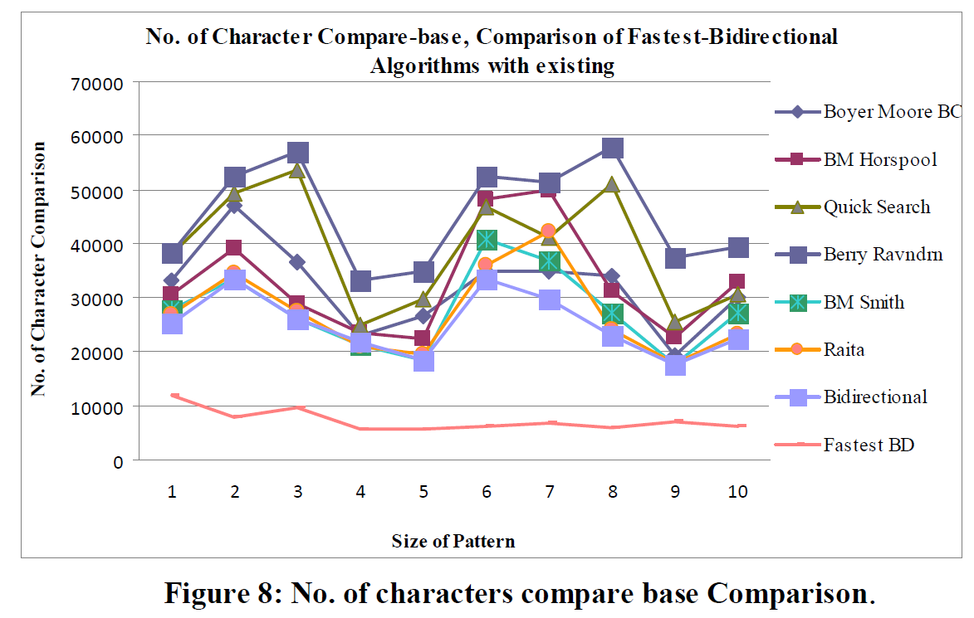
RESULTS AND DISCUSSIONS

